Slide 1
ABARNA S
Final Project
5/04/2024 Annual Review

Slide 2
MOVIE RECOMMENDATION
5/04/2024 Annual Review

Slide 3


AGENDA
PROBLEM ST A TEMENT
PROJECT OVERVIEW
END USERS
SOLUTION AND ITS VALUE PROPOSITION
THE WOW IN MY SOLUTION
MODELLING
RESULTS
3/21/2024 Annual Review

Slide 4

PROBLEM STATEMENT
In the vast landscape of streaming platforms and digital libraries, users often find themselves overwhelmed by the sheer volume of movie choices available to them. Navigating through extensive catalogs to find content that aligns with their tastes and preferences can be a daunting task, leading to decision fatigue and dissatisfaction. As a result, there's a growing need for personalized movie recommendation systems that can efficiently guide users towards content they are likely to enjoy.
5/04/2024 Annual Review

Slide 5

PROJECT OVERVIEW
Our movie recommendation project aims to revolutionize the way users discover and engage with movies by leveraging cutting-edge technology and user-centric design principles. Here's an in-depth look at our project:
Objectives:
Enhanced Discovery: We aim to simplify the movie discovery process for users by providing personalized recommendations tailored to their individual preferences and tastes.
Improved Engagement: By offering relevant and engaging movie suggestions, we seek to increase user interaction and retention on our platform.
Optimized User Experience: Our goal is to deliver a seamless and intuitive movie recommendation experience that enhances user satisfaction and enjoyment.
5/04/2024 Annual Review

Slide 6

END USERS
Understanding the diverse needs and preferences of our end users is paramount in designing a successful movie recommendation system. Here's how we're tailoring our approach to cater to the needs of our audience:
User Segmentation: We recognize that our user base comprises a wide spectrum of movie enthusiasts, each with unique tastes and viewing habits. By segmenting users based on their preferences, engagement levels, and demographics, we can deliver personalized recommendations that resonate with their interests.
Personalization: At the core of our recommendation system lies the commitment to hyper-personalization. Whether it's a casual viewer seeking entertainment options or a cinephile with specific genre preferences, our system adapts to each user's individual preferences, ensuring that every recommendation feels tailor-made.
User Feedback Integration: We value user feedback as a crucial source of insight into preferences and satisfaction levels. By incorporating user ratings, reviews, and implicit feedback signals, we continuously refine our recommendation algorithms to better align with users' evolving tastes and preferences.
Accessibility and User Experience: Ensuring accessibility and ease of use are central to our design philosophy. Our recommendation interface is intuitive and user-friendly, enabling seamless navigation and exploration of movie recommendations across devices and platforms.
Community Engagement: Fostering a sense of community and collaboration among users is integral to enhancing the overall movie-watching experience. Through features such as user-generated playlists, discussion forums, and social sharing options, we encourage interaction and engagement among users, facilitating a vibrant community of movie enthusiasts.
Empowering User Control: Recognizing the importance of user autonomy, our recommendation system empowers users with control over their recommendations. Through customizable preferences, filters, and recommendation settings, users can fine-tune their movie suggestions to align with their unique preferences and mood.
By prioritizing user-centric design principles and leveraging user insights, we're committed to delivering a movie recommendation system that not only meets but exceeds the expectations of our diverse user base.
5/04/2024 Annual Review

Slide 7
SOLUTION AND ITS VALUE PROPOSITION
The solution employs a sophisticated recommendation engine powered by machine learning techniques, specifically a Support Vector Machine (SVM) classifier. This classifier is trained on a diverse dataset of movie descriptions and associated genres, allowing it to learn intricate patterns and correlations between textual features and user preferences. By analyzing the textual descriptions of movies, the model can identify latent similarities and connections that may not be immediately apparent to human users.
The value proposition of the movie recommendation system lies in its ability to:
Provide personalized recommendations: By considering individual user preferences, viewing history, and feedback, the system delivers movie suggestions that are highly relevant and tailored to each user's tastes.
Enhance user engagement: By presenting users with a curated selection of movies that match their interests, the system increases user engagement and encourages continued exploration of the platform's content.
Streamline content discovery: By automating the process of movie discovery, the system saves users time and effort by presenting them with relevant choices without the need for extensive manual searching.
Foster user satisfaction: By consistently delivering accurate and relevant recommendations, the system enhances user satisfaction and loyalty, fostering a positive user experience.
5/04/2024 Annual Review

Slide 8

THE WOW IN MY SOLUTION
Personalization: The recommendation system leverages advanced machine learning techniques to understand and adapt to each user's unique preferences and viewing habits, resulting in highly personalized recommendations.
Efficiency: By automating the movie recommendation process, the system provides users with instant access to a curated selection of movies tailored to their tastes, saving them time and effort.
Accuracy: The SVM classifier, trained on a comprehensive dataset of movie descriptions and genres, delivers precise and relevant recommendations, ensuring a high level of accuracy and user satisfaction.
Scalability: The recommendation system is designed to scale with the platform's growing user base and content library, accommodating evolving user preferences and expanding movie catalogs.
3/21/2024 Annual Review
8

Slide 9
MODELLING
In our movie recommendation project, modeling serves as the backbone of our system, dictating the accuracy and relevance of recommendations provided to users. Here's how we're shaping our modeling approach to deliver optimal results:
Machine Learning Algorithms: We're employing a diverse set of machine learning algorithms to cater to various recommendation scenarios:
Support Vector Machine (SVM): Our baseline model, SVM, efficiently categorizes movies based on textual descriptions. Its versatility allows it to adapt to complex feature spaces, making it an ideal choice for initial classification tasks.
Collaborative Filtering: Harnessing user-item interactions, collaborative filtering identifies similarities among users or items to generate recommendations. By leveraging collective wisdom, we can offer personalized suggestions even for lesser-known movies.
5/04/2024 Annual Review
9

Slide 10
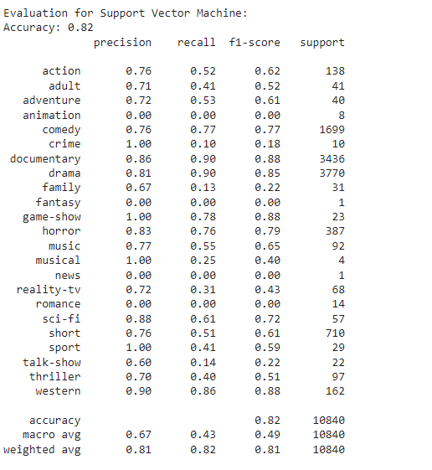
RESULTS
The SVM model demonstrates promising performance in recommending movies based on textual descriptions. Evaluation metrics such as accuracy, precision, recall, and F1-score provide insights into the model's effectiveness in predicting movie genres and delivering relevant recommendations to users
5/04/2024 Annual Review
10

